Slide 1
Chapter 3 Context-Free Grammars and Parsing

Slide 2
Context-Free Grammars and Parsing
Parsing is the task of determining the syntax, or structure, of a program. For this reason, it is also called syntax analysis. The syntax of a programming language is usually given by the grammar rules of a context-free grammar .
The rules of a context-free grammar are recursive. For instance, the structure of an if-statement must in general allow other if-statements to be nested inside it, that is not allowed in regular expressions.
The consequences of this seemingly elementary change to the power of the representation are enormous. The class of structures recognizable by context-free grammars is increased signifi­cantly over those of regular expressions.

Slide 3
Context-Free Grammars and Parsing
The algorithms used to recognize these structures are also quite different from scanning algorithms, in that they must use recursive calls or an explicitly managed parsing stack. The data structures used to represent the syntactic structure of a language must now also be recursive rather than linear (as they are for lexemes and tokens).

Slide 4
Context-Free Grammars and Parsing
二者的主要区别
在于上下文无关文法的规则是递归的（ r e c u r s i v e）。例如一般来说， if 语句的结构应允许可其中嵌套其他的i f语句，而在正则表达式中却不能这样做。这个区别造成的影响很大。由上下文无关文法识别的结构类比由正则表达式识别的结构类大大增多了。用作识别这些结构的算法也与扫描算法差别很大，这是因为它们必须使用递归调用或显式管理的分析栈。用作表示语言语义结构的数据结构现在也必须是递归的，而不再是线性的（如同用于词法和记号中的一样）了。经常使用的基本结构是一类树，称作分析树（ parse tree）或语法树（syntax tree）

Slide 5
Main content
1、study the theory of con­text-free grammars
2、a general description of the parsing process
3、study the basic theory of context-free

Slide 6
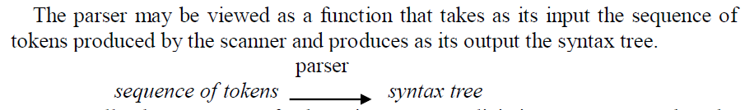
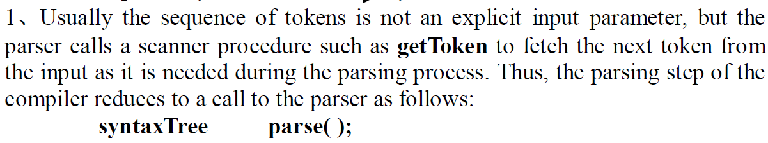
3.1 the parsing process

Slide 7
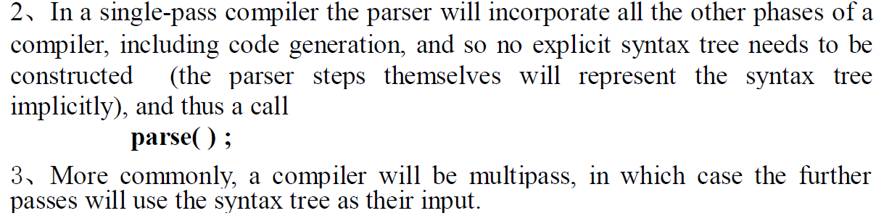
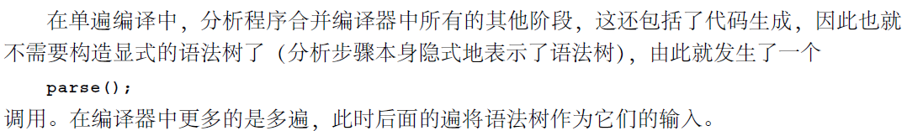
3.1 the parsing process

Slide 8
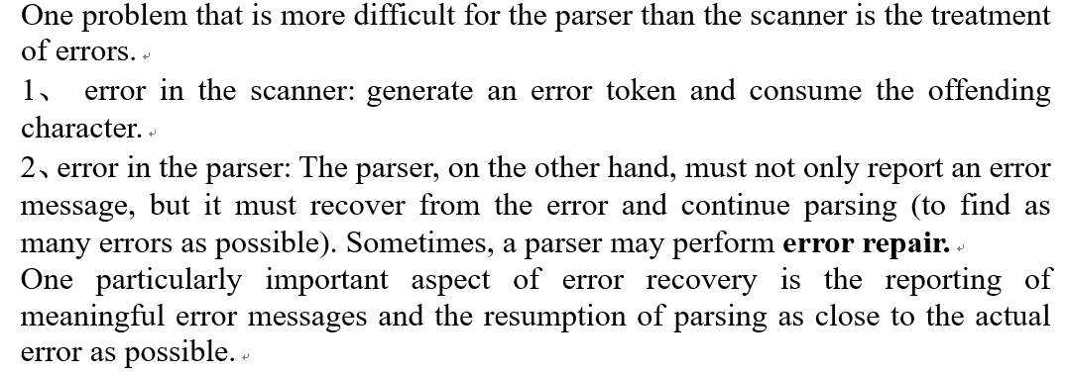
3.1 the parsing process

Slide 9
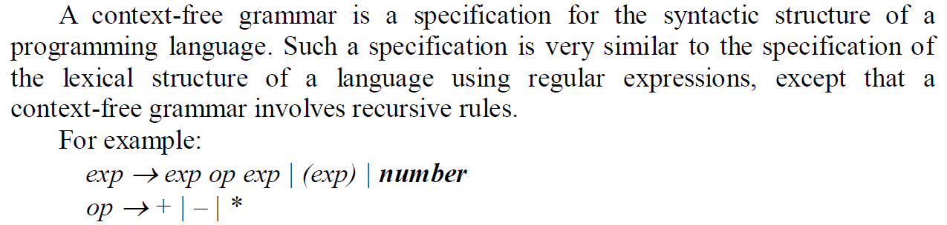
3.2 Context-free grammars
上下文无关文法说明程序设计语言的语法结构。除了上下文无关文法涉及到了递归规则之外，这样的说明与使用正则表达式的词法结构的说明十分类似

Slide 10
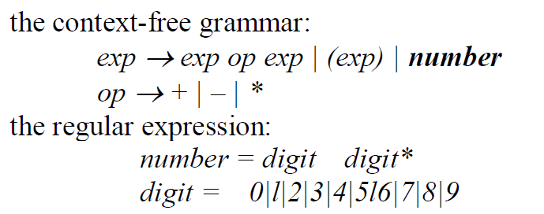
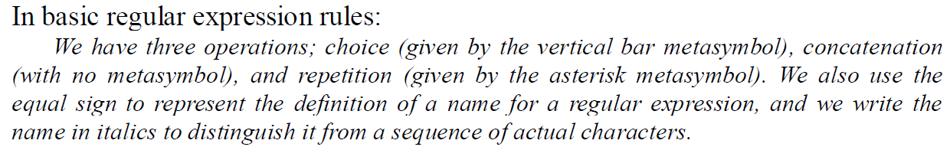
3.2.1 Comparison to regular expression notation

Slide 11
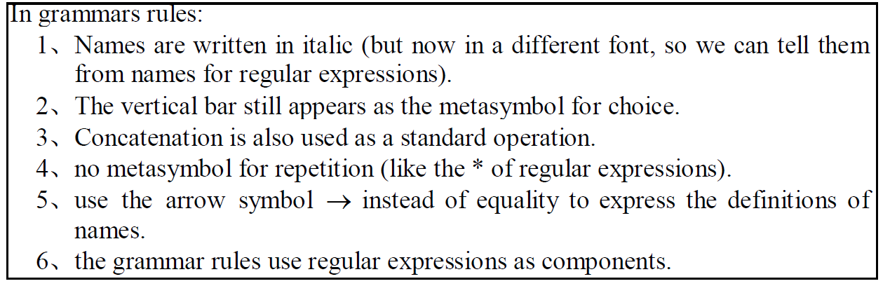
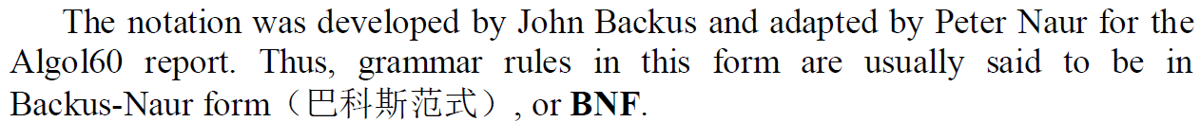
3.2.1 Comparison to regular expression notation

Slide 12
3.2.1 Comparison to regular expression notation
文法规则使用相似的表示法。名字用斜体表示（但它是一种不同的字体，所以可与正则表达式相区分）。竖线仍表示作为选择的元符号。并置也用作一种标准运算。但是这里没有重复的元符号（如正则表达式中的星号*），稍后还会再讲到它。表示法中的另一个差别是现在用箭头符号“→”代替了等号来表示名字的定义。这是由于现在的名字不能简单地由其定义取代，而需要更为复杂的定义过程来表示，这是由定义的递归本质决定

Slide 13
3.2.2 Specification of context-free grammar rules
同正则表达式类似，文法规则是定义在一个字母表或符号集之上。在正则表达式中，这些符号通常就是字符，而在文法规则中，符号通常是表示字符串的记号。
假设有一个字母表，B N F中的上下文无关文法规则（context-free grammar rule in BNF）是由符号串组成。第1个符号是结构名字，第2个符号是元字符 →，这个符号之后是一个符号串，该串中的每个符号都是字母表中的一个符号（即一个结构的名字）或是元符号｜。

Slide 14

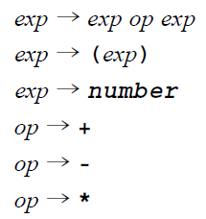
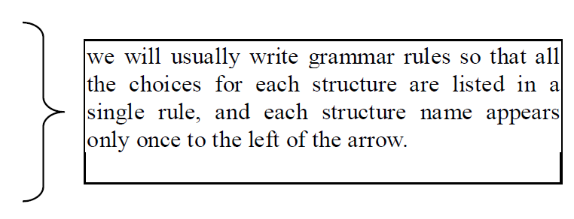
3.2.2 Specification of context-free grammar rules

Slide 15
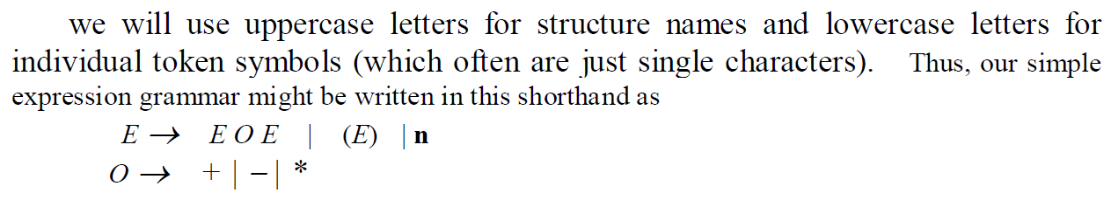
3.2.2 Specification of context-free grammar rules

Slide 16
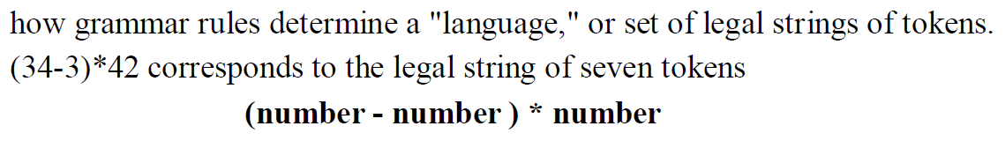
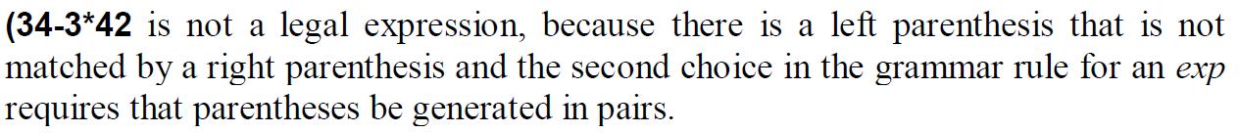
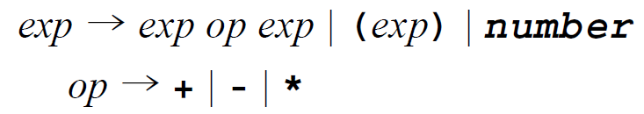
3.2.3 Derivations (推导) and the language defined by a grammar

Slide 17
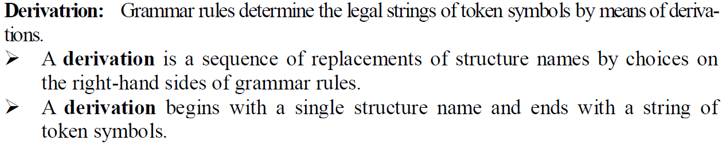
3.2.3 Derivations (推导) and the language defined by a grammar
文法规则通过推导确定记号符号的正规串。推导（derivation）是在文法规则的右边进行选择的一个结构名字替换序列。推导以一个结构名字开始并以记号符号串结束。在推导的每一个步骤中，使用来自文法规则的选择每一次生成一个替换。

Slide 18


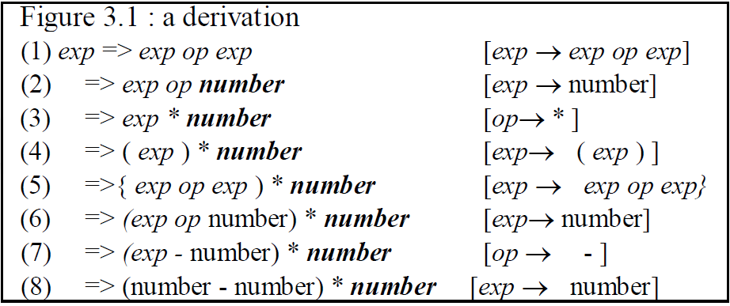
3.2.3 Derivations (推导) and the language defined by a grammar

Slide 19
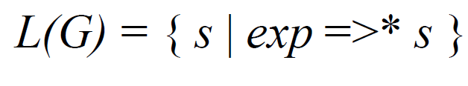
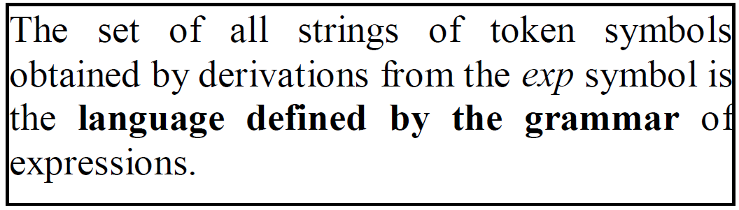
3.2.3 Derivations (推导) and the language defined by a grammar

Slide 20
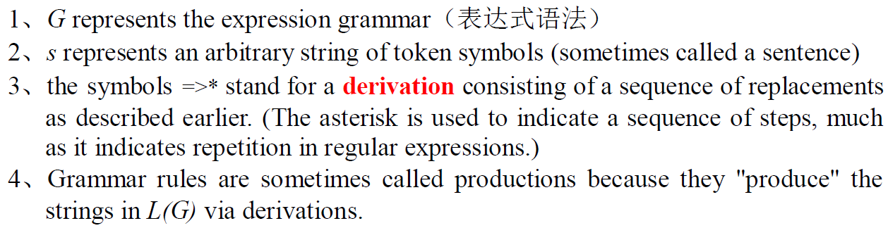
3.2.3 Derivations (推导) and the language defined by a grammar

Slide 21
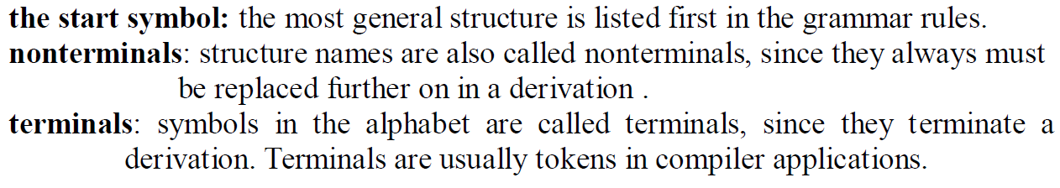

3.2.3 Derivations (推导) and the language defined by a grammar
？

Slide 22
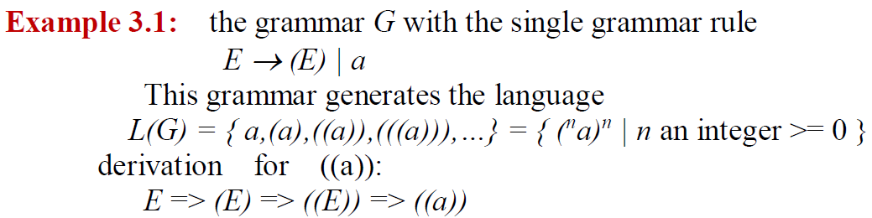
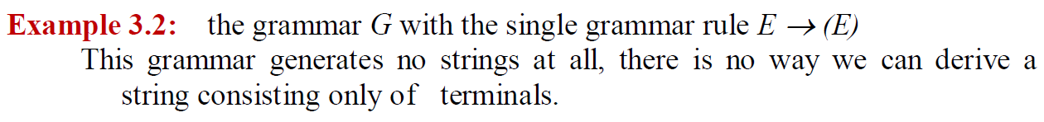
3.2.3 Derivations (推导) and the language defined by a grammar
(* a )*

Slide 23
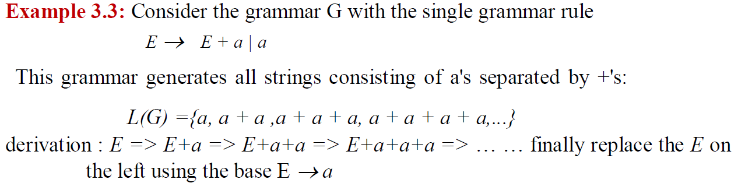
3.2.3 Derivations (推导) and the language defined by a grammar

Slide 24
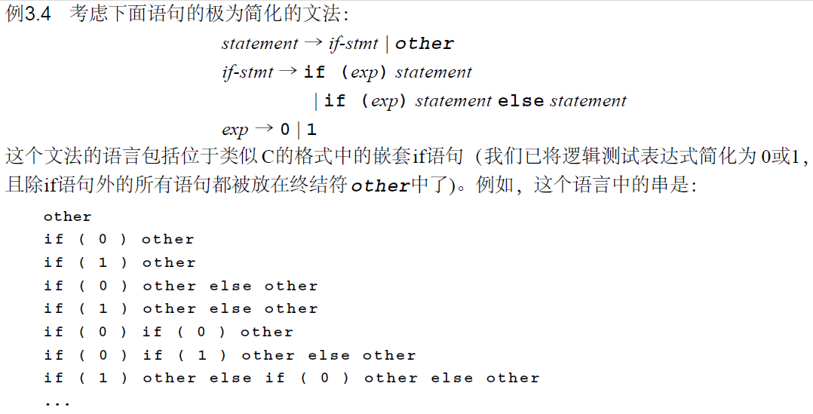
3.2.3 Derivations (推导) and the language defined by a grammar

Slide 25
3.2.3 Derivations (推导) and the language defined by a grammar
Recursion: the grammar rule A → A a | a or the grammar rule A → a A | a
generates the language {a^{n} | n is an integer >=1 } (the set of all strings of one or more a's), which is the same language as that generated by the regular expression a+.
the string aaaa can be generated by the first grammar rule with the derivation
A => Aa => Aaa => Aaaa => aaaa

Slide 26
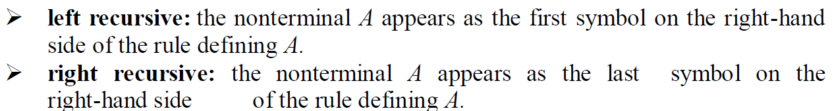
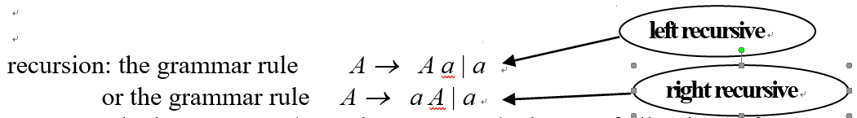
Left recursive 与 right recursive

Slide 27
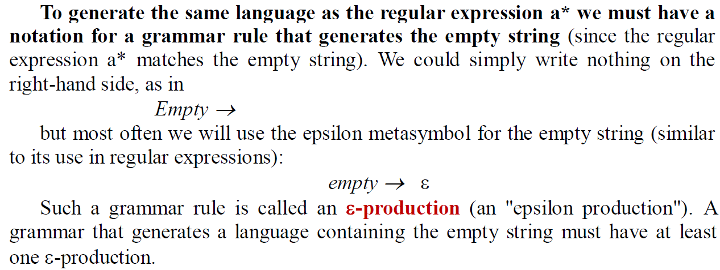
3.2.3 Derivations (推导) and the language defined by a grammar

Slide 28
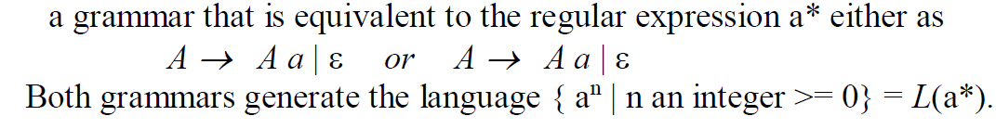
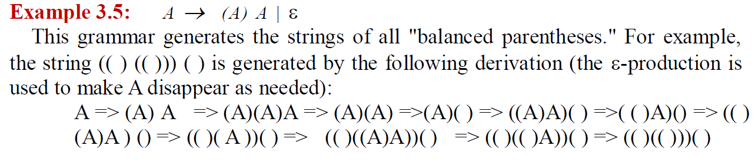
Example
如果没有ε

Slide 29
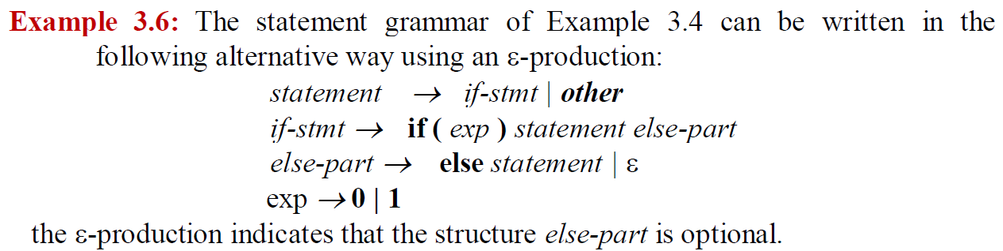
Example

Slide 30
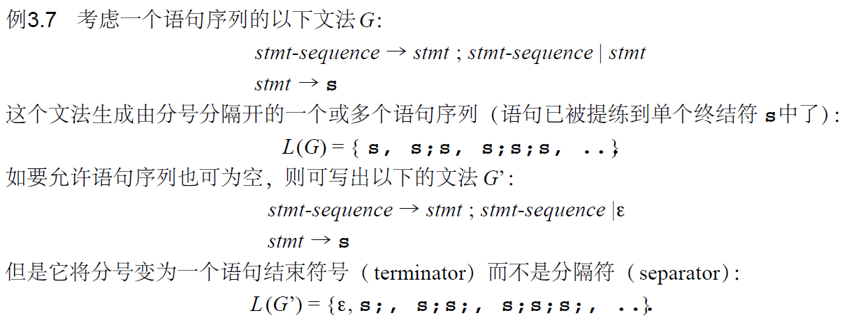
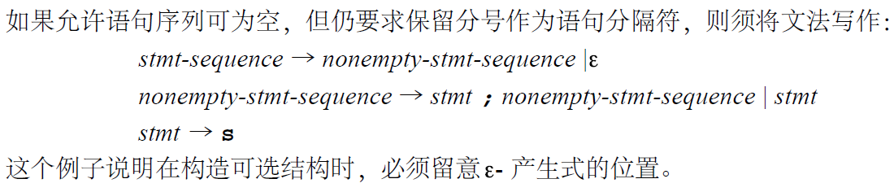

Slide 31
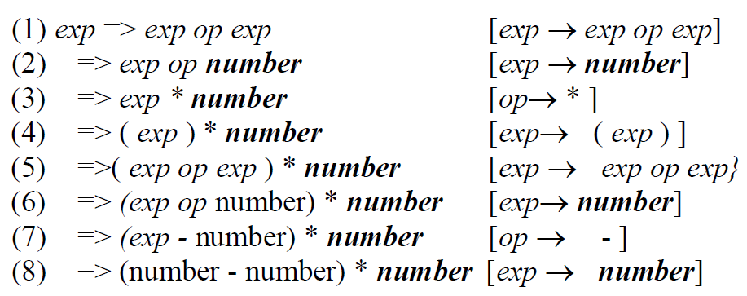
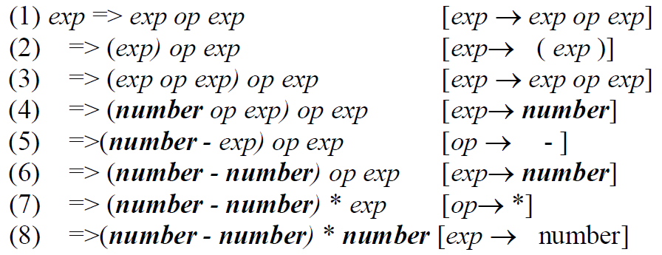
3.3 Parse trees and abstract syntax trees
Derivations do not uniquely represent the structure of the strings they construct. In general, there are many derivations for the same string.
( number - number ) * number

Slide 32
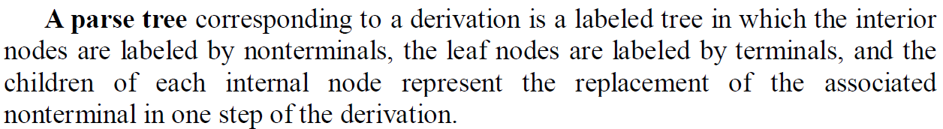
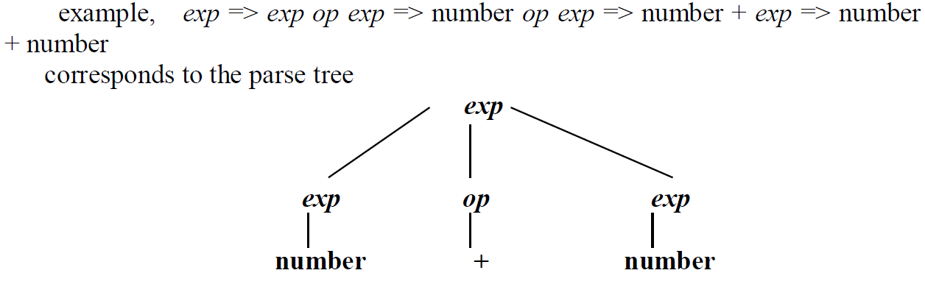
3.3.1 Parse trees

Slide 33
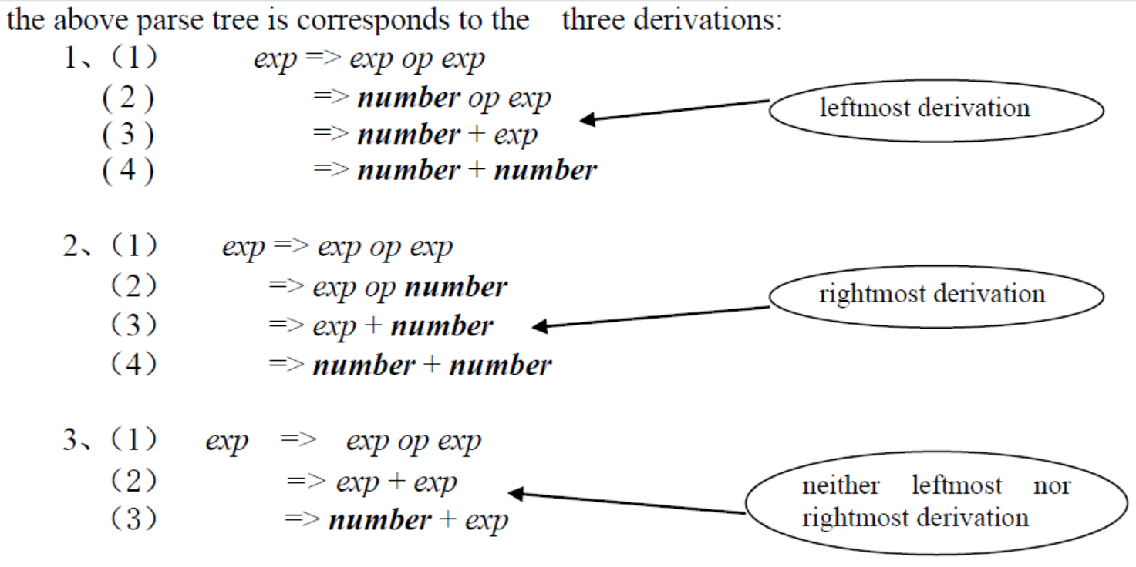
3.3.1 Parse trees

Slide 34
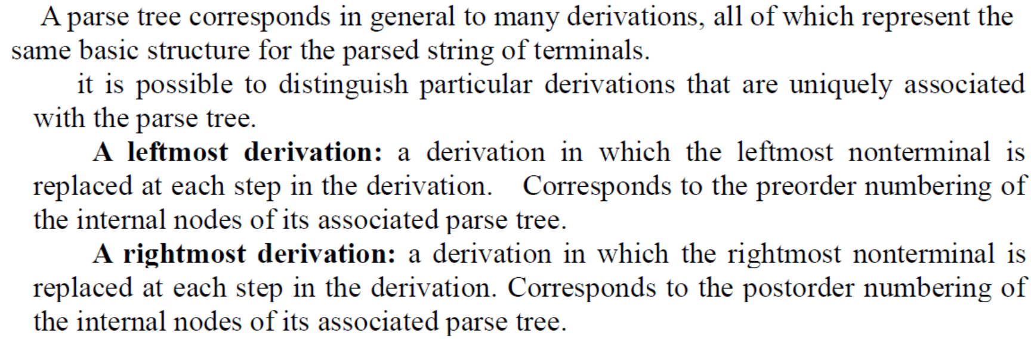
3.3.1 Parse trees

Slide 35
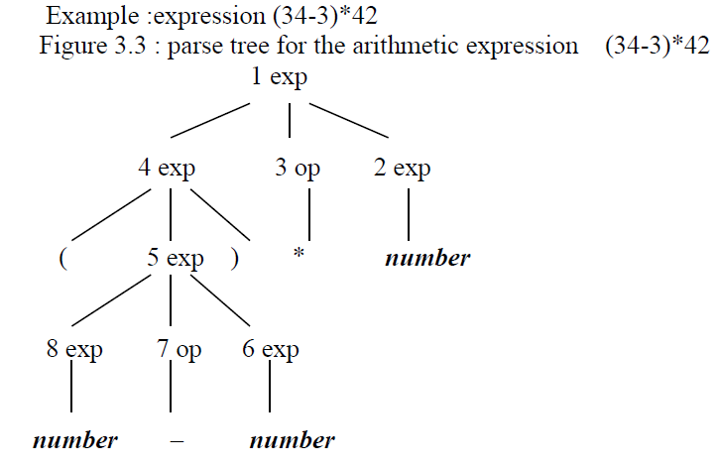
3.3.1 Parse trees
Leftmost derivation
or rightmost derivation?

Slide 36
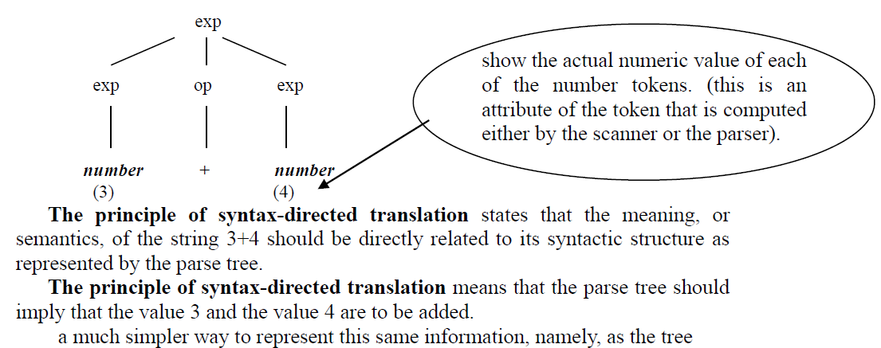
3.3.2 Abstract syntax trees

Slide 37
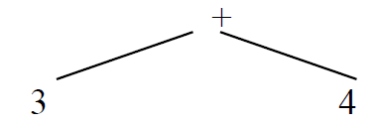
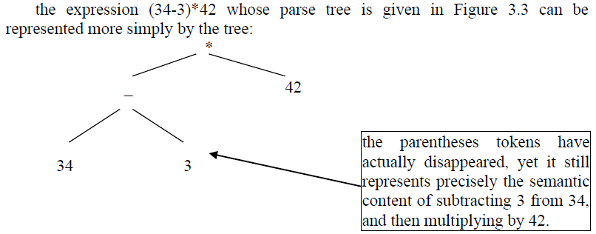
3.3.2 Abstract syntax trees
a much simpler way to represent this same information, namely, as the tree.

Slide 38
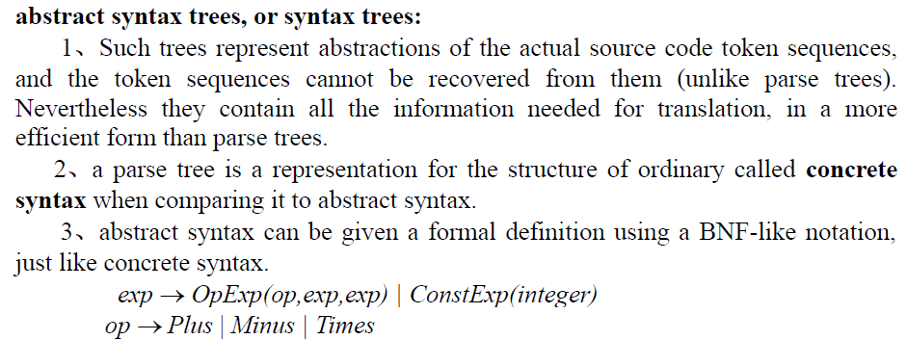
3.3.2 Abstract syntax trees

Slide 39
3.3 Parse trees and abstract syntax trees
这种树是真正的源代码记号序列的抽象表示。虽然不能从其中重新得到记号序列（不同于分析树），但是它们却包含了转换所需的所有信息，而且比分析树效率更高。这样的树称作抽象语法树（abstract syntax tree）或简称为语法树（syntax tree）。分析程序可通过一个分析树表示所有步骤，但却通常只能构造出一个抽象的语法树（或与它等同的）

Slide 40
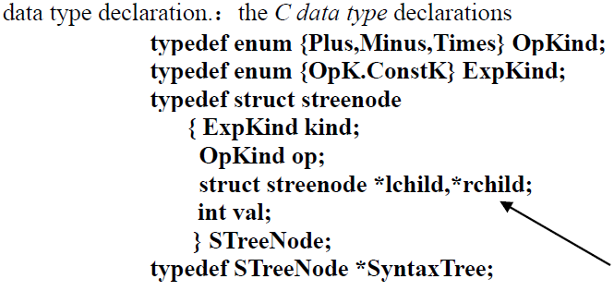
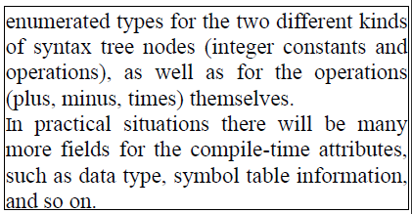
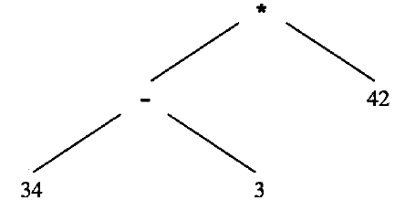

Slide 41
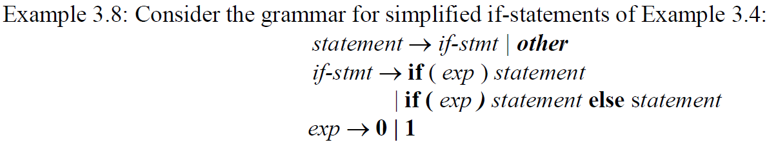

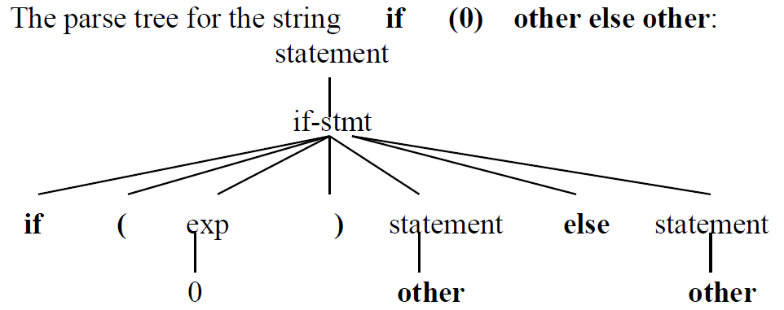
Parse Tree ?

Slide 42


Parse Tree ?

Slide 43



3.3 Parse trees and abstract syntax trees

Slide 44





Slide 45



3.4 Ambiguity

Slide 46




3.4 Ambiguity

Slide 47


3.4 Ambiguity
Notes:
由于这个文法
并不能准确地指出程序的语法结构（即使是完全确定正规串本身（它是文法的语言成员）），所
以它是分析程序表示的一个严重问题。在某种意义上，二义性文法就像是一个非确定的自动机，
此时两个不同的路径都可接收相同的串。但是因为没有一个合适的算法，因此就不能像自动机
中的情形一样（第2章中讨论过的子集构造），文法中的二义性就不能如有穷自动机中的非确定
性一样轻易地被解

Slide 48
3.4 Ambiguity
Two basic methods are used to deal with ambiguities.
(1) One is to state a rule that specifies in each ambiguous case which of the parse trees (or syntax trees) is the cor­rect one. Such a rule is called a disambiguating rule.
The advantage: it corrects the ambiguity without changing (and possibly complicating) the gram­mar.
The disadvantage: the syntactic structure of the language is no longer given by the grammar alone.
(2) change the grammar into a form that forces the construction of the correct parse tree, thus removing the ambiguity.

Slide 49
3.4 Ambiguity
Of course, in either method we must first decide which of the trees in an ambiguous case is the cor­rect one.
我们所需的分析（或语法）树应能够正确地反映将来应用到构造的意义，以便将其翻译成目标代码
Example： 34 – 3 * 42
precedence

Slide 50
3.4 Ambiguity
To remove the given ambiguity in our simple expression grammar:
We could now simply state a disambiguating rule that establishes the relative precedences of the three operations represented. The standard solution is to give addition and subtraction the same precedence, and to give multiplication a higher precedence.
a further ambiguity requiring a disambiguating rule is the associativity of each of the operations of addition, subtraction, and multiplication. It is common to specify that all three of these operations are left associative.

Slide 51


3.4 Ambiguity
例如串3 4 - 3 - 4 2，这个串有两种可能的语法树：
associativity
标准数学规定第1种选择是正确的。这是由于规定减法为左结合( left associativity)，也就是认为一个减法序列的运算是自左向右的.

Slide 52



3.4 Ambiguity
specify that an operation is nonassociative, in that a sequence of more than one operator in an expression is not allowed. We could, for instance, have written our simple expression grammar in the following form:

Slide 53


3.4.2 Precedence and associativity
group the operators into groups of equal precedence, and for each precedence we must write a different rule.
为了处理文法中的运算优先权问题，就必须把具有相同优先权的算符归纳在一组中，并为每一种优先权规定不同的规则。例如，可把乘法比加法和减法优先添加到简单表达式文法，如下所示
在这个文法中，乘法被归在t e r m规则下，而加法和减法则被归在e x p规则之下。
addition and subtraction will appear "higher" (that is, closer to the root) in the parse and syntax trees, and thus receive lower precedence.

Slide 54
3.4.2 Precedence and associativity
a precedence cascade: a grouping of oper­ators into different precedence levels is a standard method in syntactic specification using BNF.
这样将算符放在不同的优先权级别中的办法是在语法说明中使用B N F的一个标准方法。这种分组称作优先级联（precedence cascade）

Slide 55

3.4.2 Precedence and associativity

Slide 56


3.4.2 Precedence and associativity

Slide 57

3.4.2 Precedence and associativity

Slide 58

3.4.2 Precedence and associativity

Slide 59

3.4.2 Precedence and associativity
Note that the precedence cascades cause the parse trees to become much more complex. The syntax trees, however, are not affected.

Slide 60

3.4.3 The dangling else problem

Slide 61


3.4.3 The dangling else problem

Slide 62



3.4.3 The dangling else problem

Slide 63
3.4.3 The dangling else problem

Slide 64


3.4.3 The dangling else problem
VS

Slide 65


Slide 66




3.4.3 The dangling else problem
Notes:
括号关键字

Slide 67


3.4.4 Inessential ambiguity

Slide 68


3.5 extended notations: EBNF and syntax diagrams
EBNF notation

Slide 69



3.5.1 EBNF notation

Slide 70


3.5.1 EBNF notation

Slide 71
3.5.1 EBNF notation
EBNF

Slide 72




3.5.1 EBNF notation

Slide 73



3.5.2 Syntax diagrams

Slide 74




3.5.2 Syntax diagrams

Slide 75








Slide 76






Slide 77


3.6 Formal properties of context-free language

Slide 78


3.6 Formal properties of context-free language

Slide 79


3.6 Formal properties of context-free language

Slide 80


3.6 Formal properties of context-free language

