Slide 1
Chapter 4 Top-Down Parsing

Slide 2
Top-Down Parsing
Top-Down Parsing
It parses an input string of tokens by tracing out the steps in a leftmost derivation. And the implied traversal of the parse tree is a preorder traversal and, thus, occurs from the root to the leaves.
Two forms of Top-Down Parsers
Predictive parsers: attempts to predict the next construction in the input string using one or more look-ahead tokens
Backtracking parsers: try different possibilities for a parse of the input, backing up an arbitrary amount in the input if one possibility fails. It is more powerful but much slower, unsuitable for practical compilers.
自顶向下的分析程序有两类：回溯分析程序backtracking parser和预测分析程序predictive parser。预测分析程序试图利用一个或多个先行记号来预测出输入串中的下一个构造，而回溯分析程序则试着分析其他可能的输入，当一种可能失败时就要求输入中备份任意数量的字符。虽然回溯分析程序比预测分析程序强大许多，但它们都非常慢。

Slide 3
Top-Down Parsing
Two kinds of Top-Down parsing algorithms
Recursive-descent parsing: is quite versatile and suitable for a handwritten parser.
LL(1) parsing: The first “L” refers to the fact that it processes the input from left to right; The second “L” refers to the fact that it traces out a leftmost derivation for the input string; The number “1” means that it uses only one symbol of input to predict the direction of the parse.
Look-Ahead Sets
First and Follow sets: are required by both recursive-descent parsing and LL(1) parsing.
Notes:
versatile英[ˈvɜːsətaɪl

Slide 4
4.1 TOP-DOWN PARSING BY RECURSIVE-DESCENT
4.1.1 The Basic Method of Recursive-Descent
The idea of Recursive-Descent Parsing
We view the grammar rule for a non-terminal A as a definition for a procedure to recognize an A, while the right-hand side of the grammar for A specifies the structure of the code for this procedure.
一个选择中的终结符与非终结符序列与相匹配的输入以及对其他过程的调用相对应，而选择与在代码中的替代情况（ case语句和if语句）相对应。

Slide 5
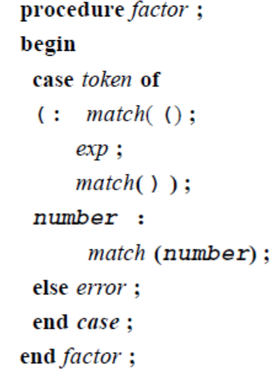
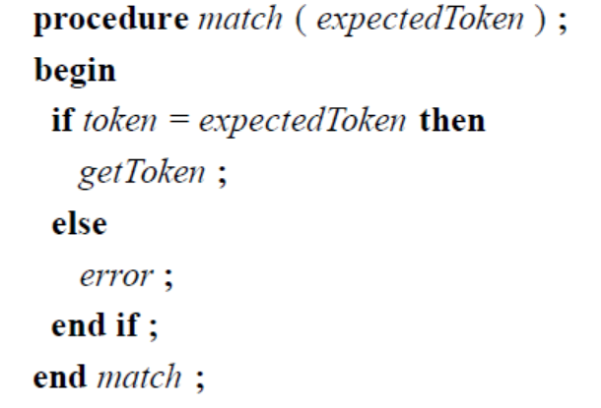
4.1.1 The Basic Method of Recursive-Descent
The Expression Grammar:
expr → expr addop term∣term
addop → + -
term → term mulop factor ∣ factor
mulop →*
factor →(expr) ∣ number
A recursive-descent procedure that recognizes a factor is as follows (in pseudo-code):

Slide 6
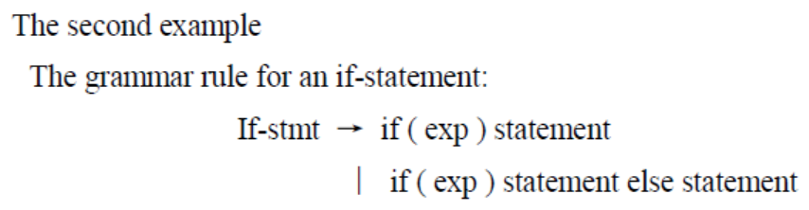
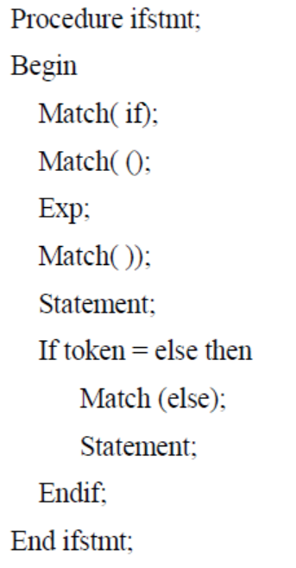
4.1.2 Repetition and Choice: Using EBNF
The procedure that can be translated into:
Notes
Writing recursive-decent procedure for the remaining rules in the expression grammar is not as easy for factor. It requires the use of EBNF

Slide 7
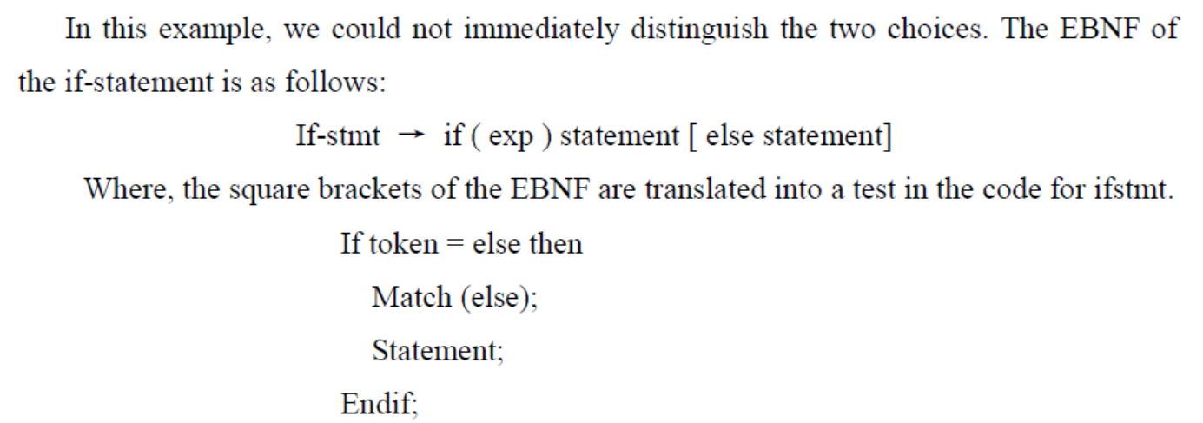
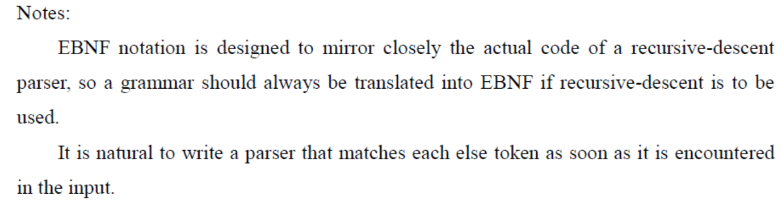
4.1.2 Repetition and Choice: Using EBNF

Slide 8
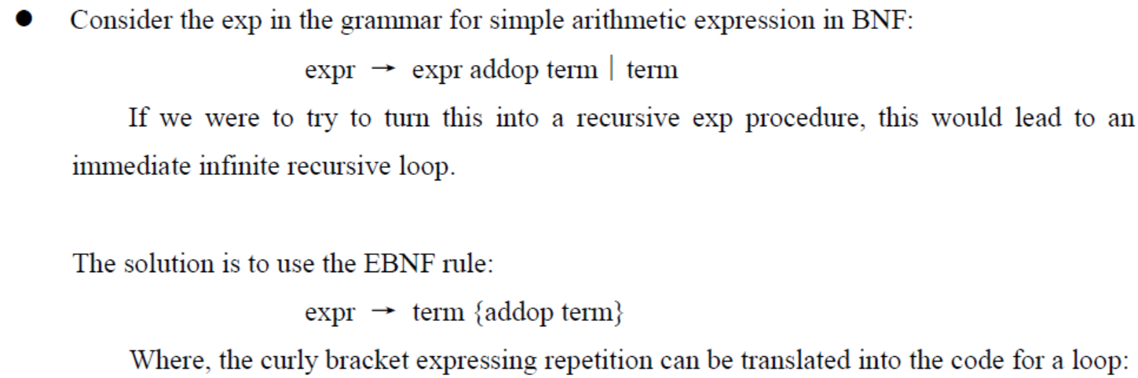
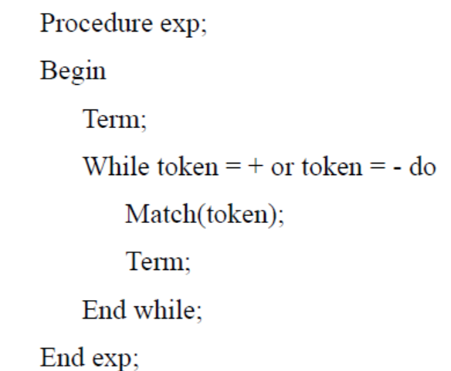

Slide 9
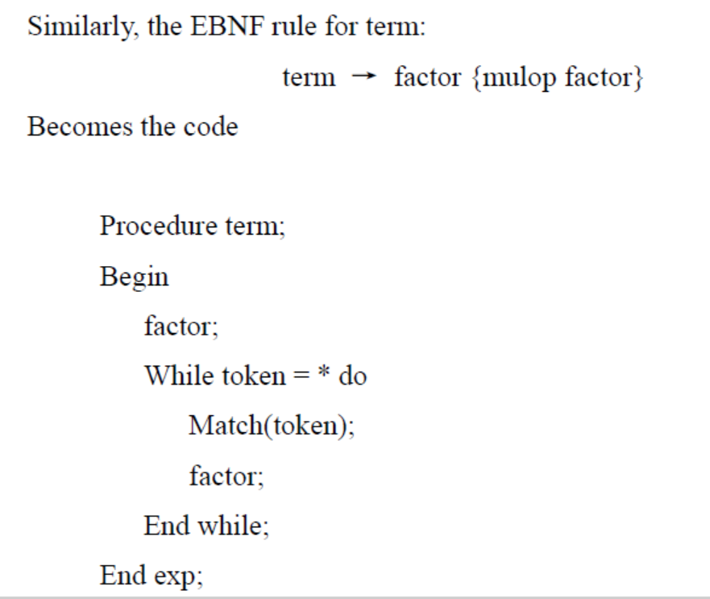
4.1.2 Repetition and Choice: Using EBNF

Slide 10
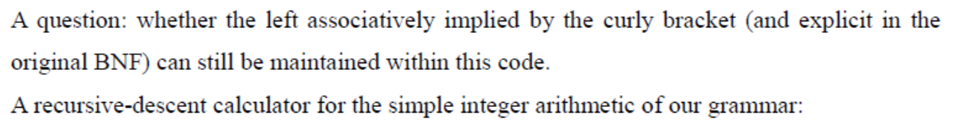
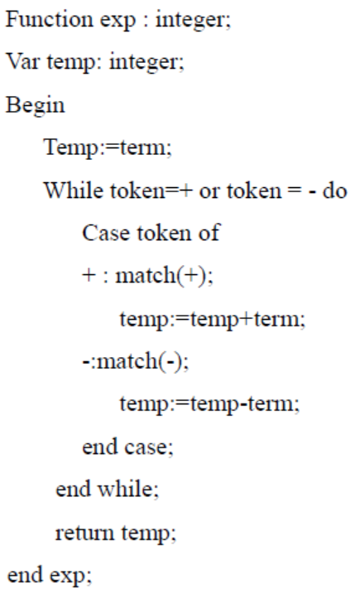
4.1.2 Repetition and Choice: Using EBNF
We can ensure that the operations are left associative by performing the operations as we cycle through the loop.

Slide 11
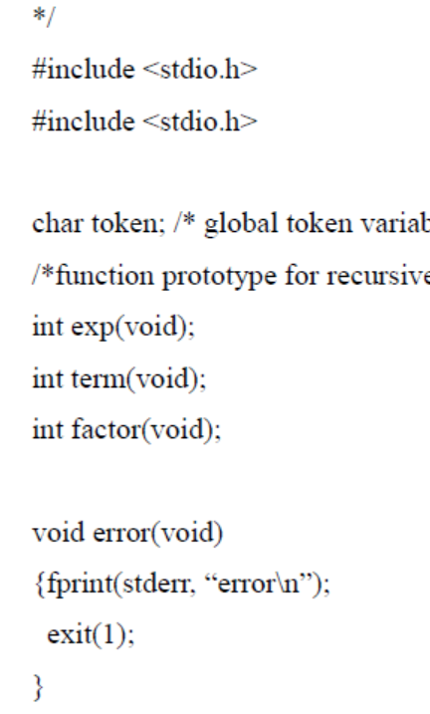
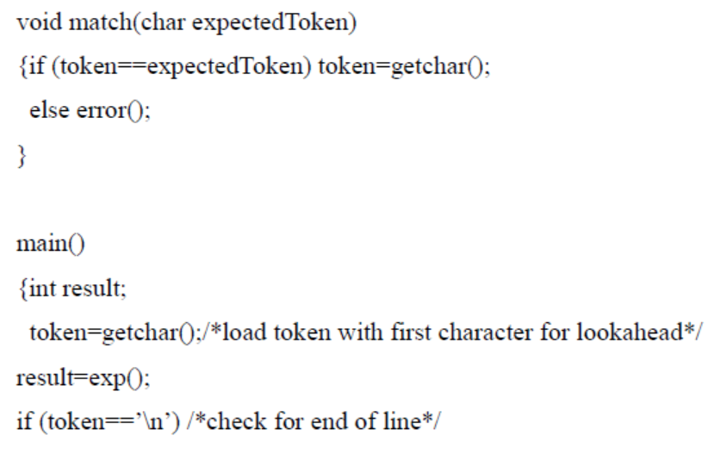
4.1.2 Repetition and Choice: Using EBNF
A working simple calculator in C code
…...

Slide 12
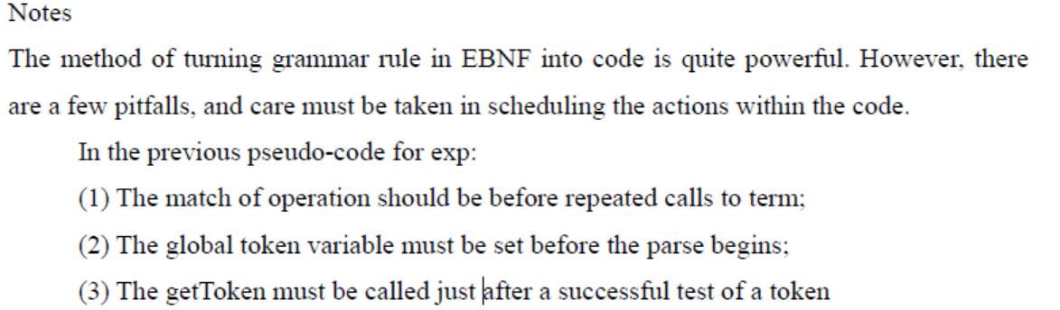
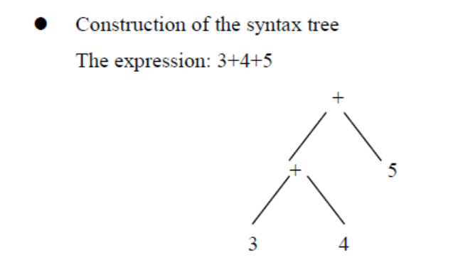

Slide 13
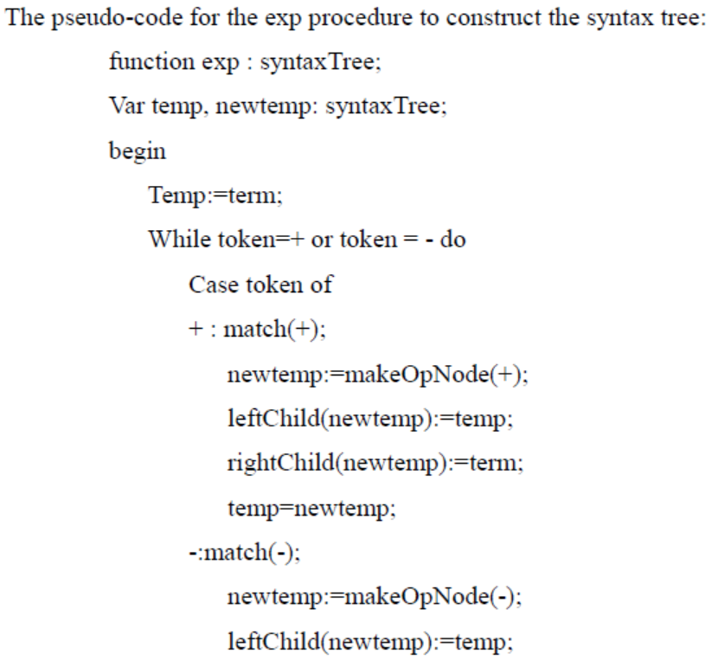
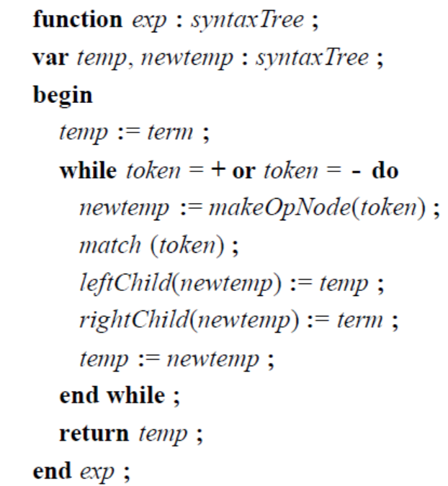
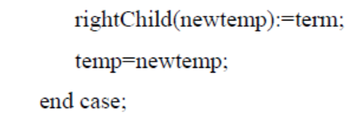

Slide 14
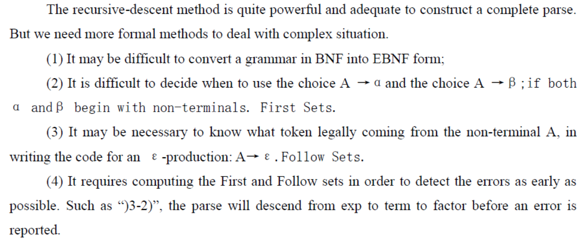
4.1.3 Further Decision Problems

Slide 15
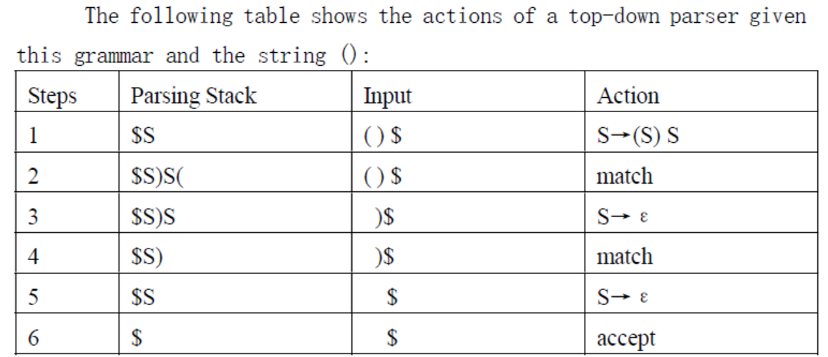

4.2 LL(1) PARSING
4.2.1 The Basic Method of LL(1) Parsing
Main idea: LL(1) Parsing uses an explicit stack rather than recursive calls to perform a parse.
An example:
A simple grammar for the strings of balanced parentheses:

Slide 16
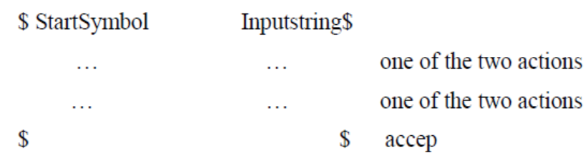
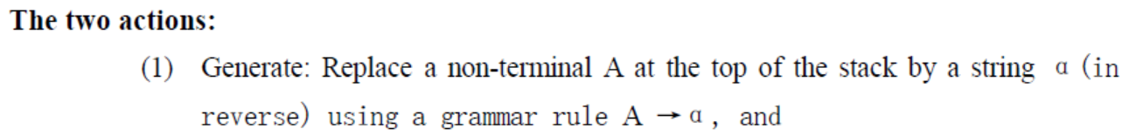
4.2 LL(1) PARSING

Slide 17
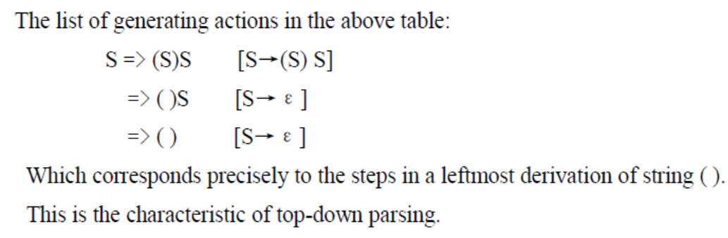
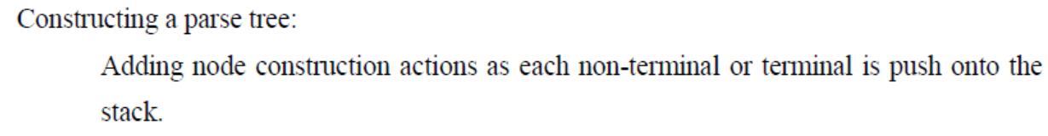
4.2 LL(1) PARSING

Slide 18
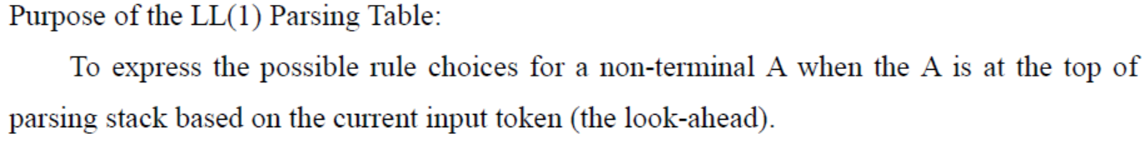
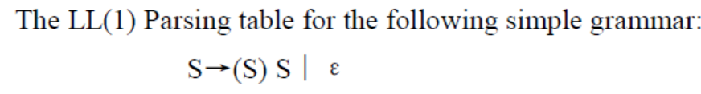
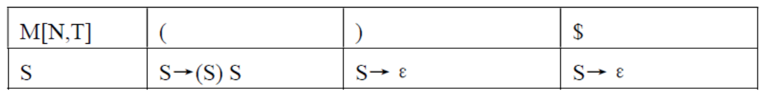
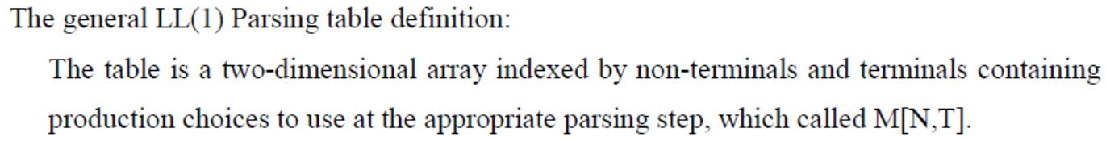
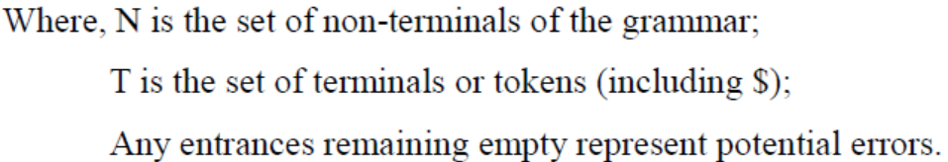
The LL(1) Parsing Table and Algorithm

Slide 19
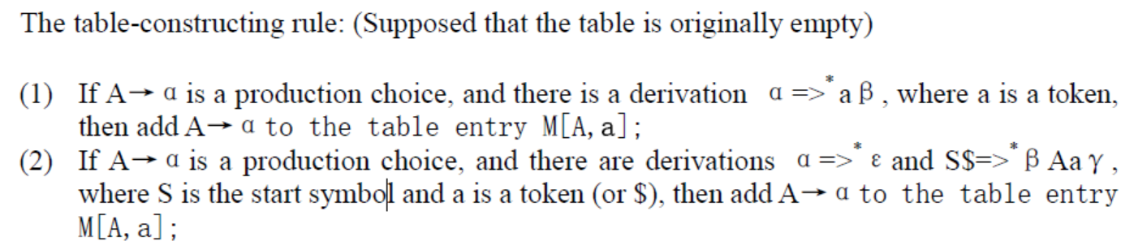
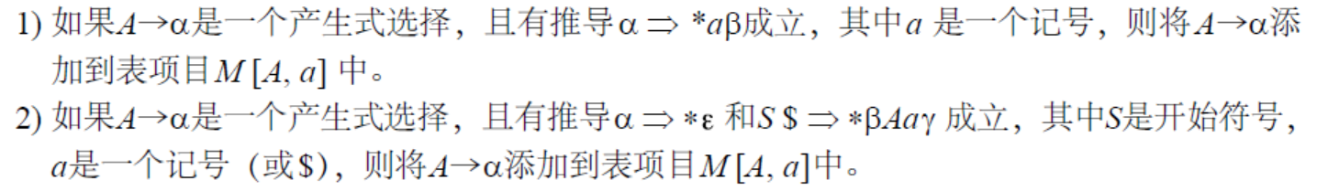
4.2.2 The LL(1) Parsing Table and Algorithm

Slide 20
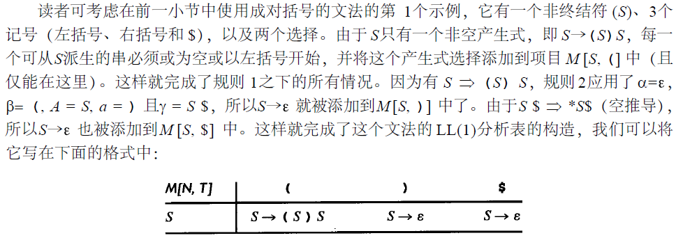

Slide 21
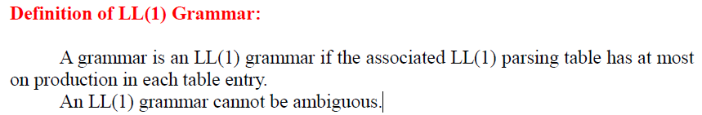
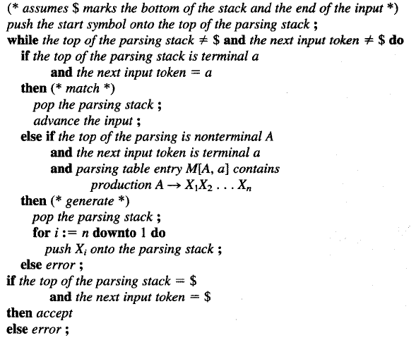
Definition of LL(1) Grammar:
A Parsing Algorithm Using the LL(1) Parsing Table:

Slide 22
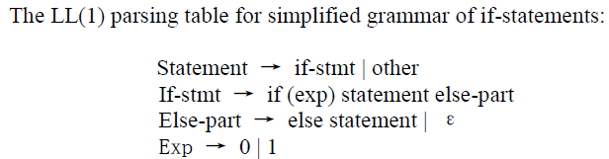
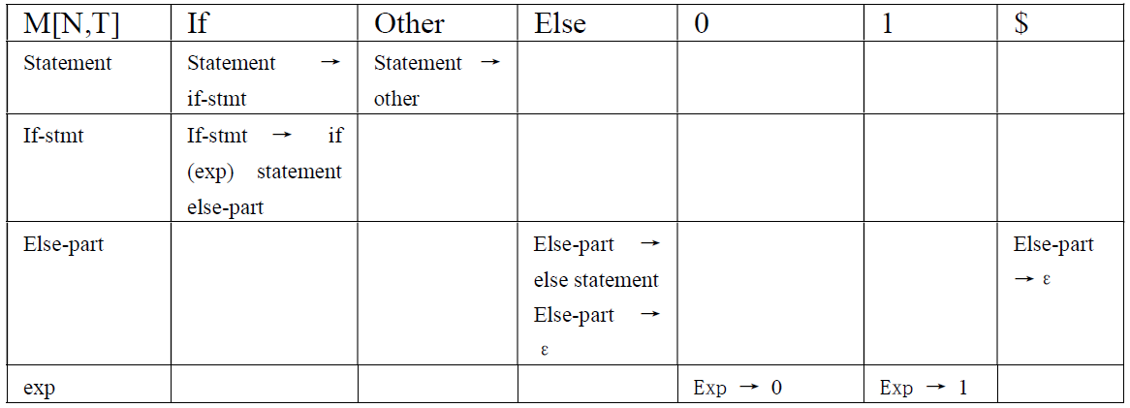
The LL(1) Parsing Table and Algorithm

Slide 23
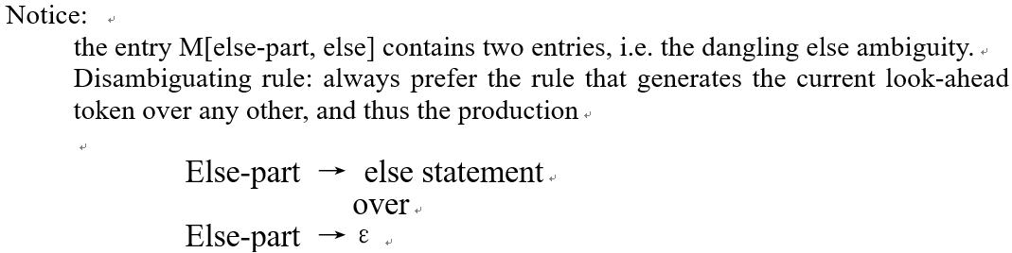
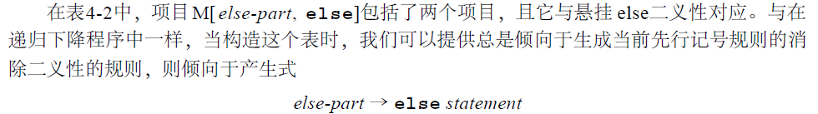
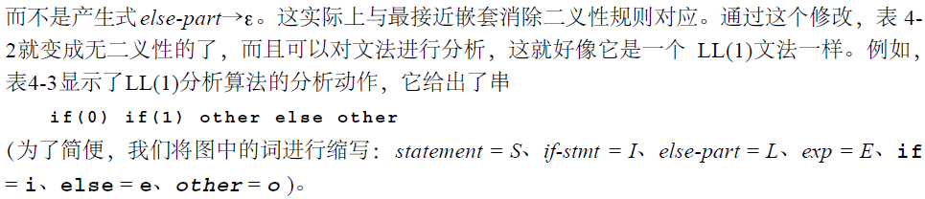

Slide 24
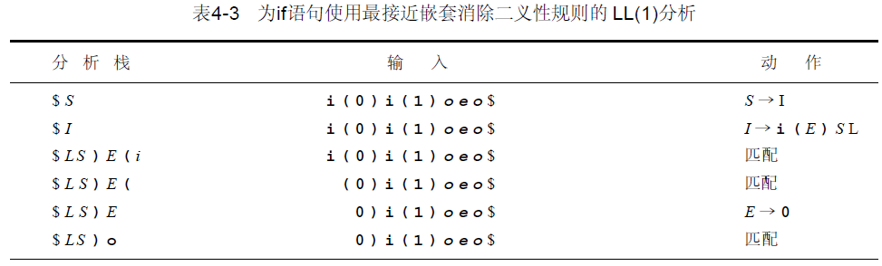
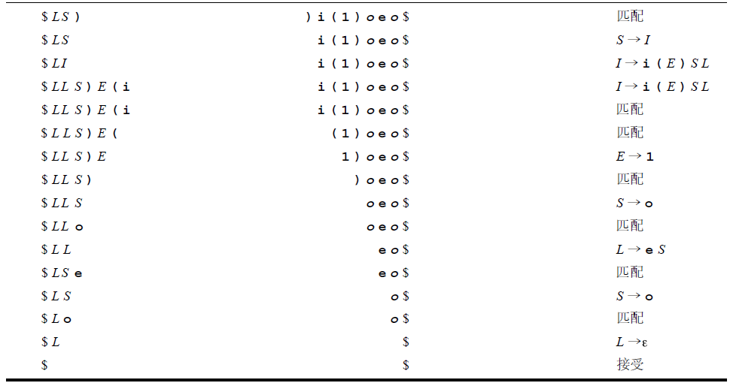

Slide 25
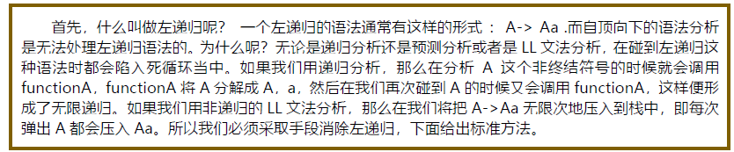
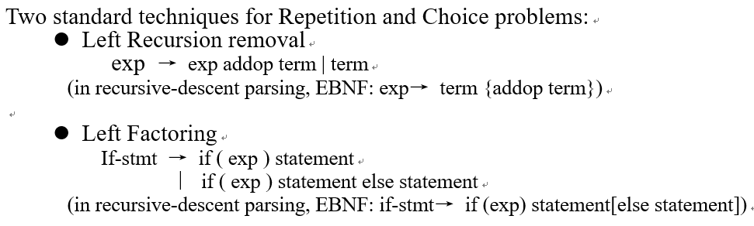
4.2.3 left Recursion Removal and Left Factoring

Slide 26
Left Recursion Removal
Left recursion is commonly used to make operations left associative, as in the simple expression grammar, where
exp → exp addop term | term
Immediate left recursion: the left recursion occurs only within the production of a single non-terminal.
Indirect left recursion:
A → Bb |…
B → Aa |…

Slide 27
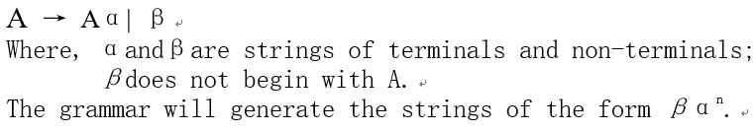
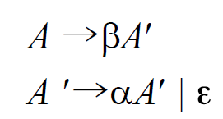

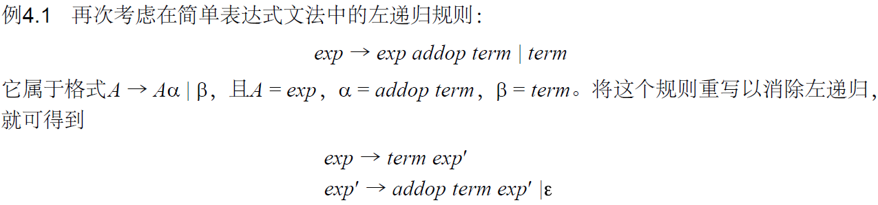
Left Recursion Removal
为了消除左递归，将这个文法规则重写为两个规则：一个是首先生成β，另一个是生成α的重复，它不用左递归却用右递归：

Slide 28
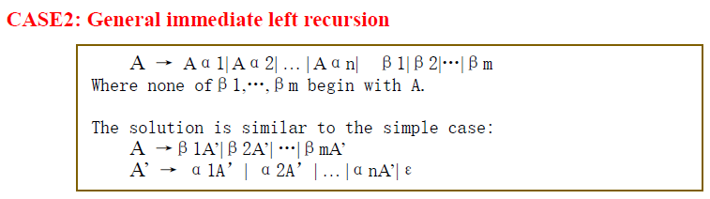
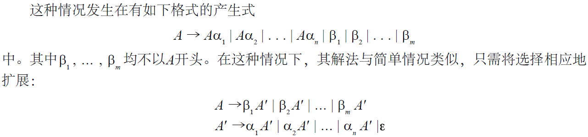
Left Recursion Removal

Slide 29
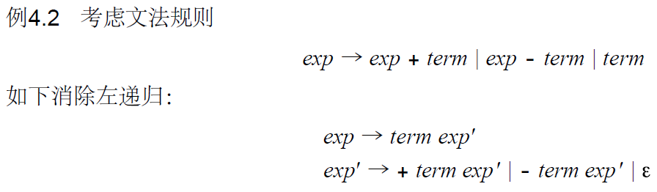
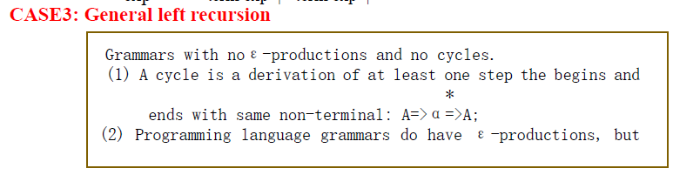
Left Recursion Removal
usually in very restricted forms.

Slide 30


Left Recursion Removal

Slide 31


Now, the grammar has no left recursion.

Slide 32



Left Recursion Removal
The parse tree for the expression 3-4-5, which not express the left associativity of subtraction.

Slide 33

Left Recursion Removal
The parse tree for the expression 3-4-5, which not express the left associativity of subtraction. Nevertheless, a parse should still construct the appropriate left associative syntax tree:

Slide 34



Left Recursion Removal

Slide 35

Left Recursion Removal

Slide 36



Left factoring
Left factoring is required when two or more grammar rule choices share a common prefix string, as in the rule

Slide 37


Left factoring

Slide 38


Left factoring

Slide 39

Left factoring
这与通过消除左递归而从左递归规则中得到的文法相同

Slide 40



Left factoring
应指出在所有的例子中，我们已使提取左因子确实在转换之后变成了L L ( 1 )文法。

Slide 41
4.2.4 Syntax Tree Construction in LL(1) Parsing
It is more difficult for LL(1) to adapt to syntax tree construction.
(1) The structure of the syntax tree can be obscured by left factoring and left recursion removal;
(2) The parsing stack represents only predicated structure, not structure that have been actually seen.
The solution:
(1) An extra stack is used to keep track of syntax tree nodes, and
(2) “action”markers are placed in the parsing stack to indicate when and what actions on the tree stack should occur.

Slide 42


4.2.4 Syntax Tree Construction in LL(1) Parsing

Slide 43

4.2.4 Syntax Tree Construction in LL(1) Parsing

Slide 44


Slide 45



4.3 FIRST AND FOLLOW SETS

Slide 46


FIRST SETS

Slide 47


FIRST SETS

Slide 48




FIRST SETS

Slide 49


FIRST SETS
The computation process for above First Set:

Slide 50

FIRST SETS

Slide 51


FIRST SETS

Slide 52

FIRST SETS

Slide 53



4.3.2 Follow Sets
Definition:

Slide 54

4.3.2 Follow Sets
Given a grammar rule A →αB, Follow(B) will contain Follow(A),the opposite of the situation for first sets, if A → B α ,First(A) contains First(B),except possibly for ε.

Slide 55

4.3.2 Follow Sets

Slide 56



4.3.2 Follow Sets
Example: the simple expression grammar.

Slide 57


4.3.2 Follow Sets

Slide 58

4.3.2 Follow Sets

Slide 59




4.3.2 Follow Sets

Slide 60

4.3.2 Follow Sets

Slide 61


4.3.2 Follow Sets

Slide 62



4.3.3 Constructing LL(1) Parsing Tables
The table-constructing rules, which had been mentioned

Slide 63




Slide 64

Applying the LL(1) parsing table construction just described, we get the table as follows.

Slide 65




Slide 66




Example

Slide 67

4.3.4 Extending the lookahead: LL(k) Parsers

